Slide 1
Sculpture Finalist
Spring and Fall 2013
Kimble

Slide 2
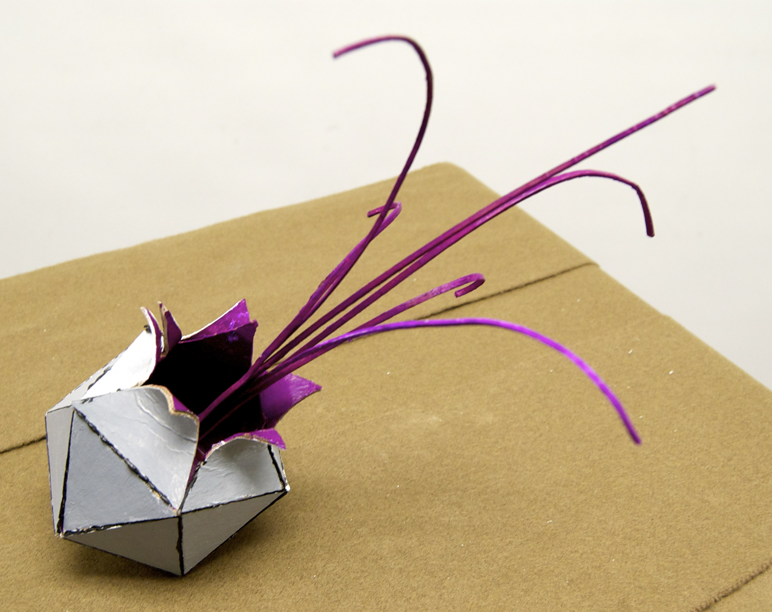
Evan

Slide 3
Evan Economos - Untitled
The sculpture I was inspired by was T8 by Mark di Suvero. That sculpture is made out of industrial girders and just exuded movement to me. It was all red and to me, it looked like they were bursting out of a single point. My goal for the project was to make a sculpture that was visually pleasing yet conveyed a definite idea. The idea is that creativity overcomes blandness. This idea is signified by the grey outside being blandness and the bright pink exploding out.
I chose to use chipboard and acrylic paint. In my mind, the best simulated actual construction because metal would have similar properties. The pieces were bonded by hot glue for the same reason: it best simulated construction (welding). As for strengths and weaknesses, I think the strength is implied movement. Movement was what I gathered from T8 and that was what I tried to capture. My weakness would be lack of clean construction. It was hard to be exact with all my triangles, which made for an inexact sphere. I think my sculpture should be chosen because it conveys a good idea and is nice to look at as well. In my eyes, the outside would be some sort of brushed silver metal so it is slightly reflective but not totally. The inside would be painted or some other mathod to obtain the brightness quality. I would want the exploding arms to be somewhat flexible so there is an element of movement but not so they fall over and lose their shape. If possible, I would like to see a light inside to better show the difference from the inside of the sphere to the outside especially at night.

Slide 4
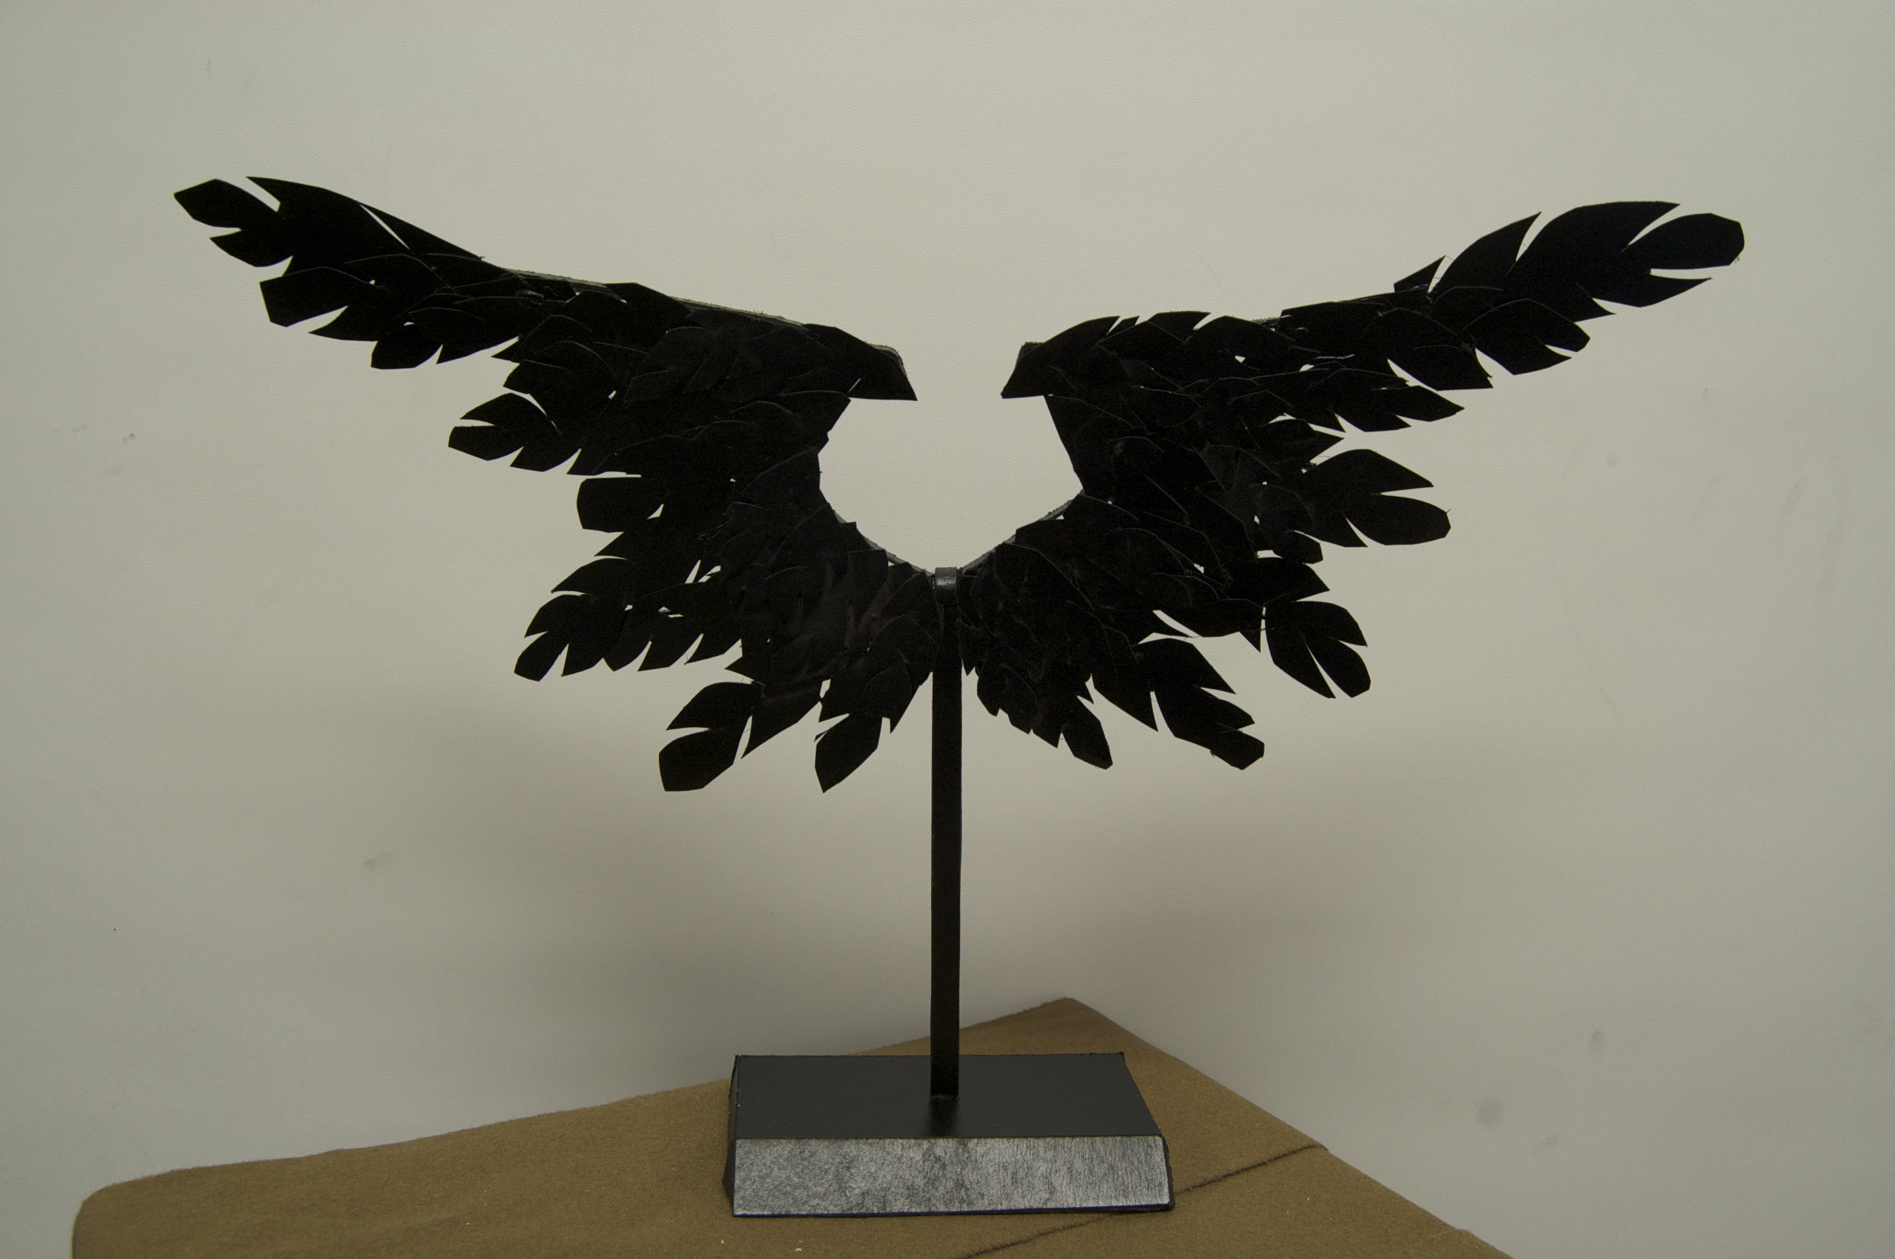
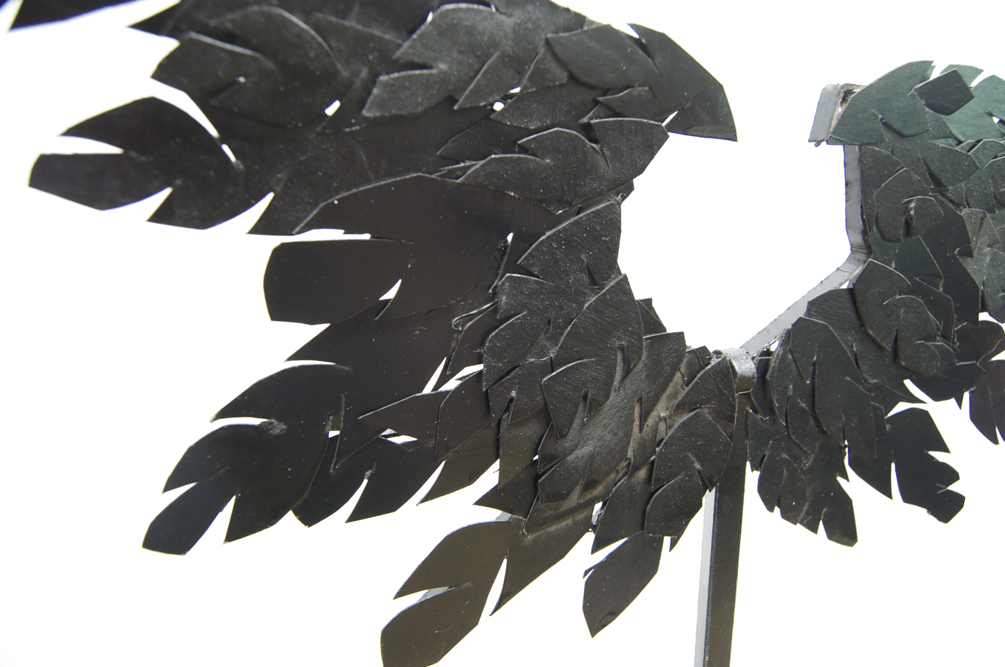
Alyssa Mendoza

Slide 5
Alyssa Mendoza - Celestial
The sculpture that I was given to recreate was the “Acient Forest and Juno” by Deborah Butterfield. Deborah composed the bodies of the sculptures from large pieces of branches and logs, and then sent them to foundry to be cast in bronze. Her initial theme of the sculpture is ghostlike and nature. My goal for this project when first starting out was to follow along the lines of Deborah’s theme while recreating something that the general public could then interact with.
The material that I used to make a model was cardboard because like Deborah, I wanted my sculpture to be skeletal based and I thought that the strands of cardboard related back to the branches that Deborah used in her piece. A weakness of my piece is that I didn’t get to incorporate enough of Deborah’s style with in my own piece as much as I would have liked to. A strength of my piece is that the concept of my piece is a generally good idea. I think my piece should be chosen for the public art piece because this piece would provide the public with not only something different, but something they could interpret and interact with.

Slide 6
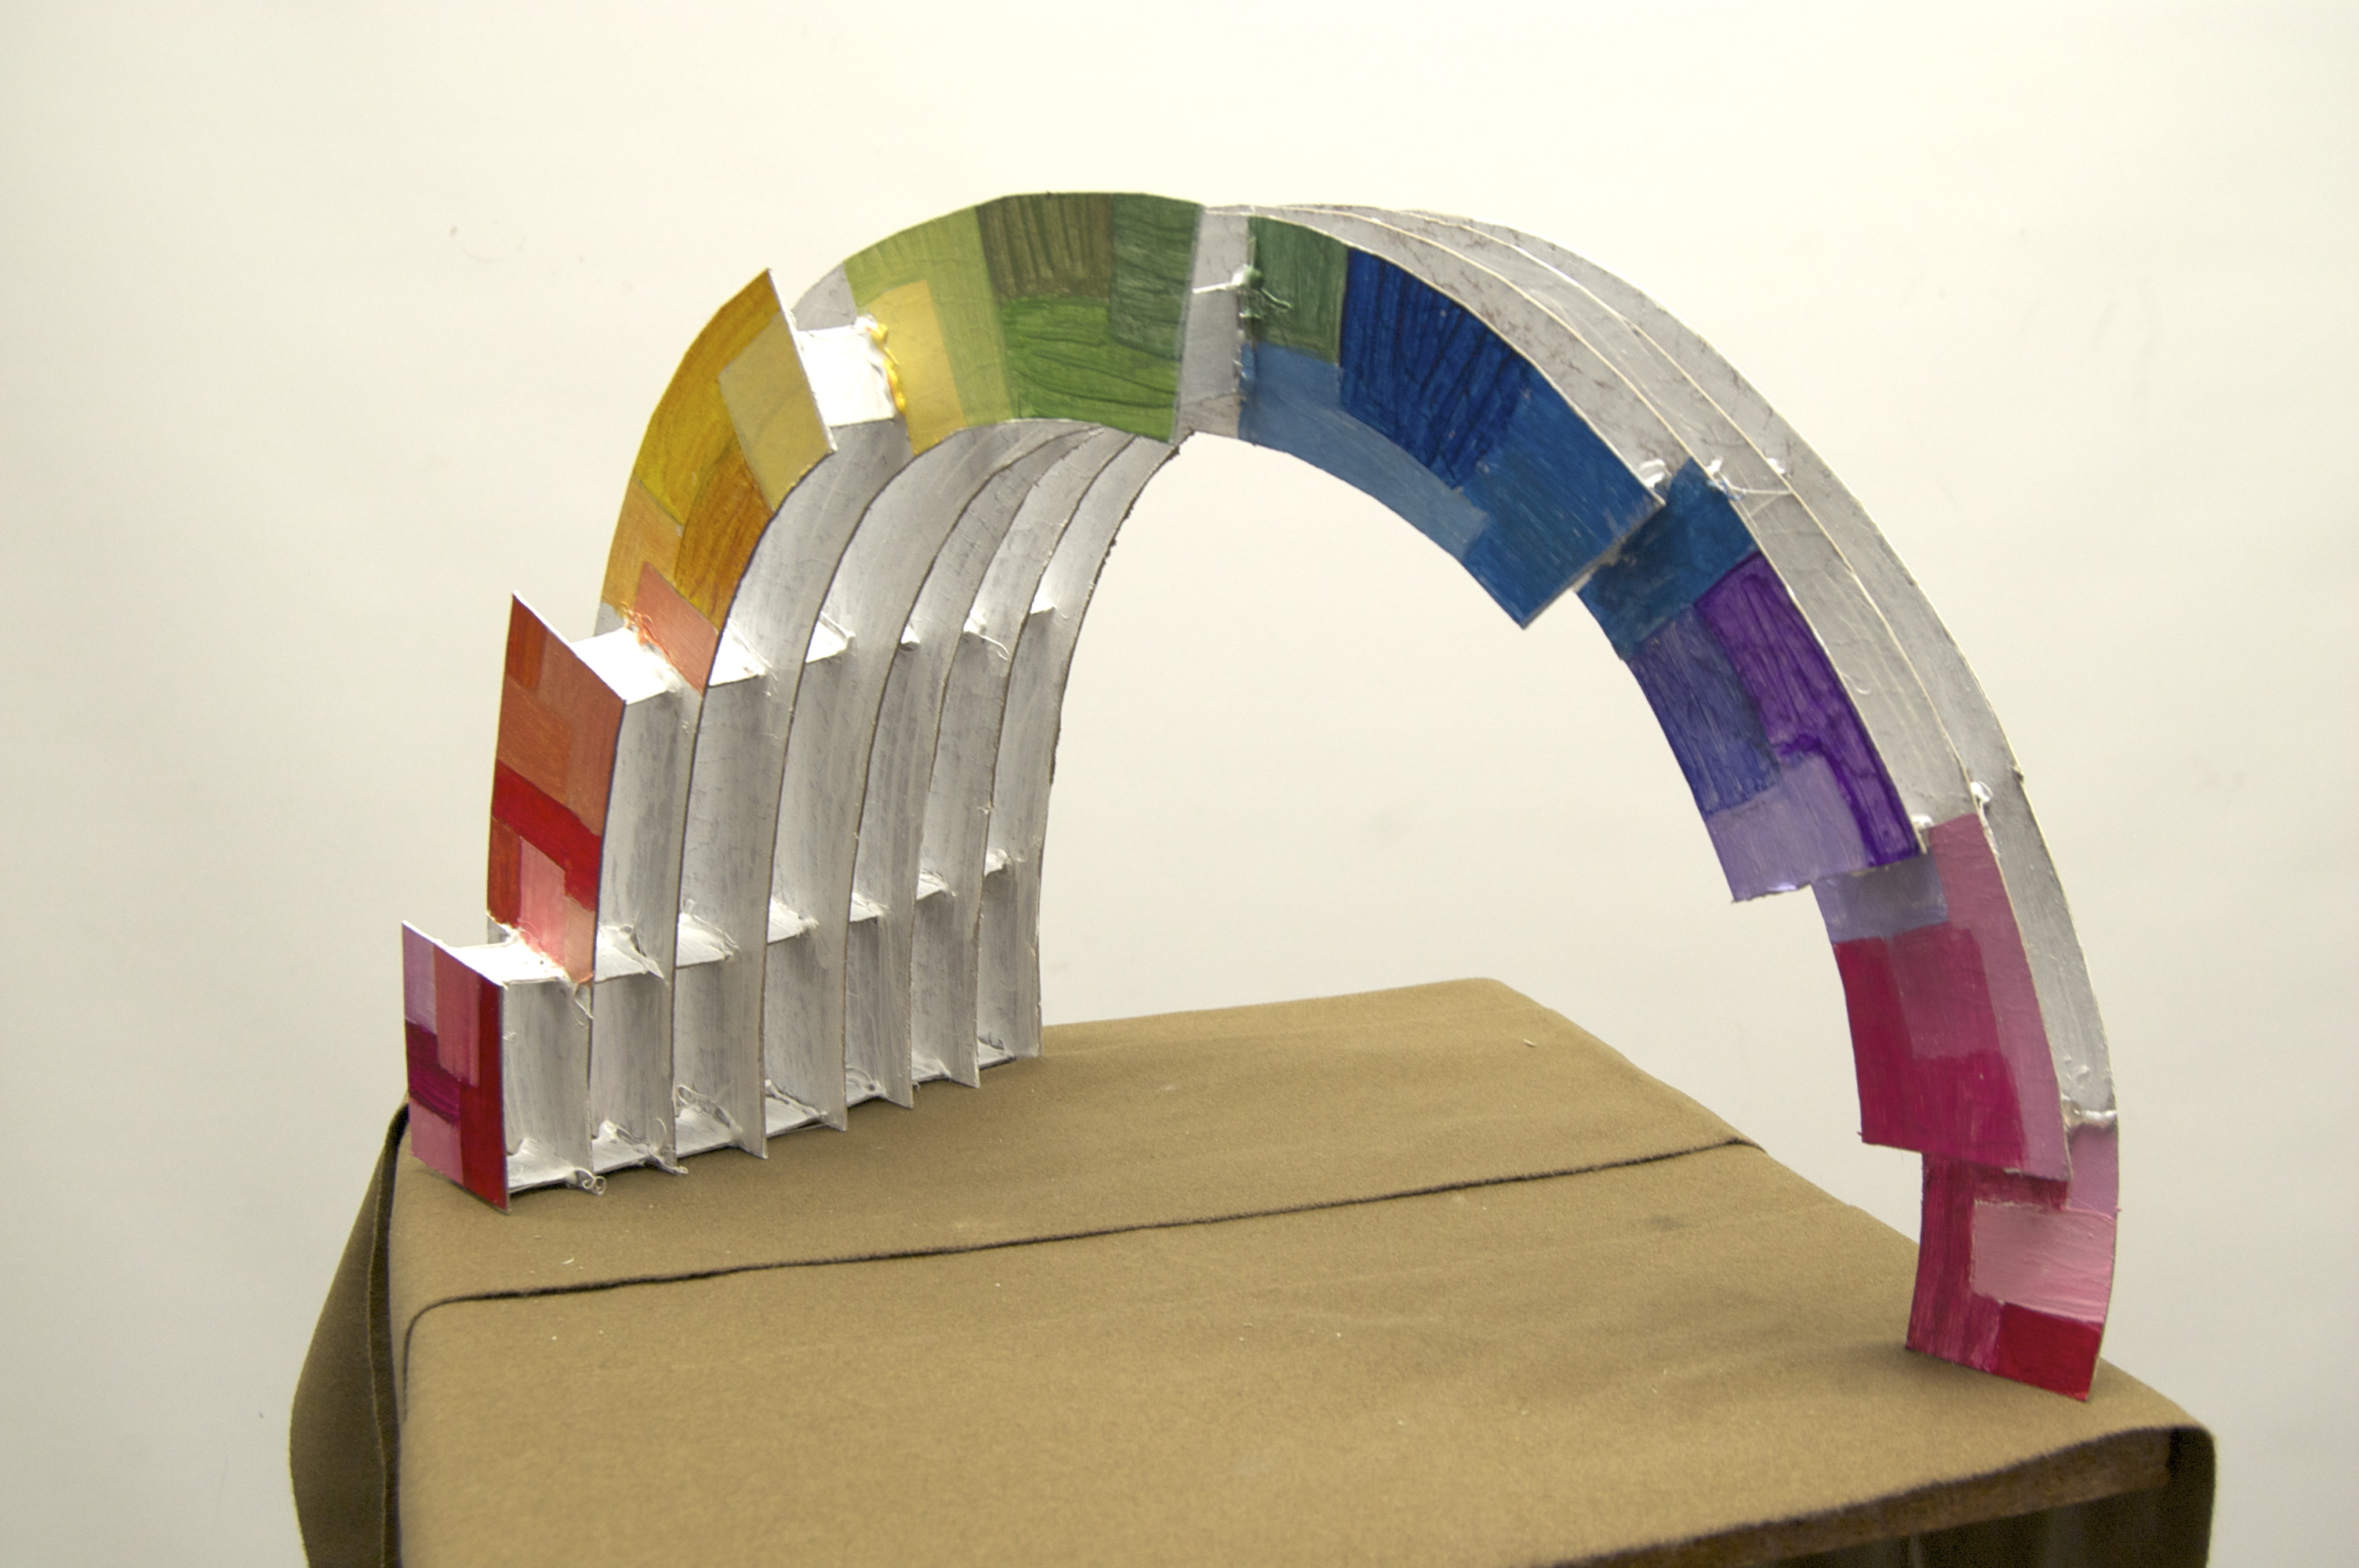
Bethany

Slide 7
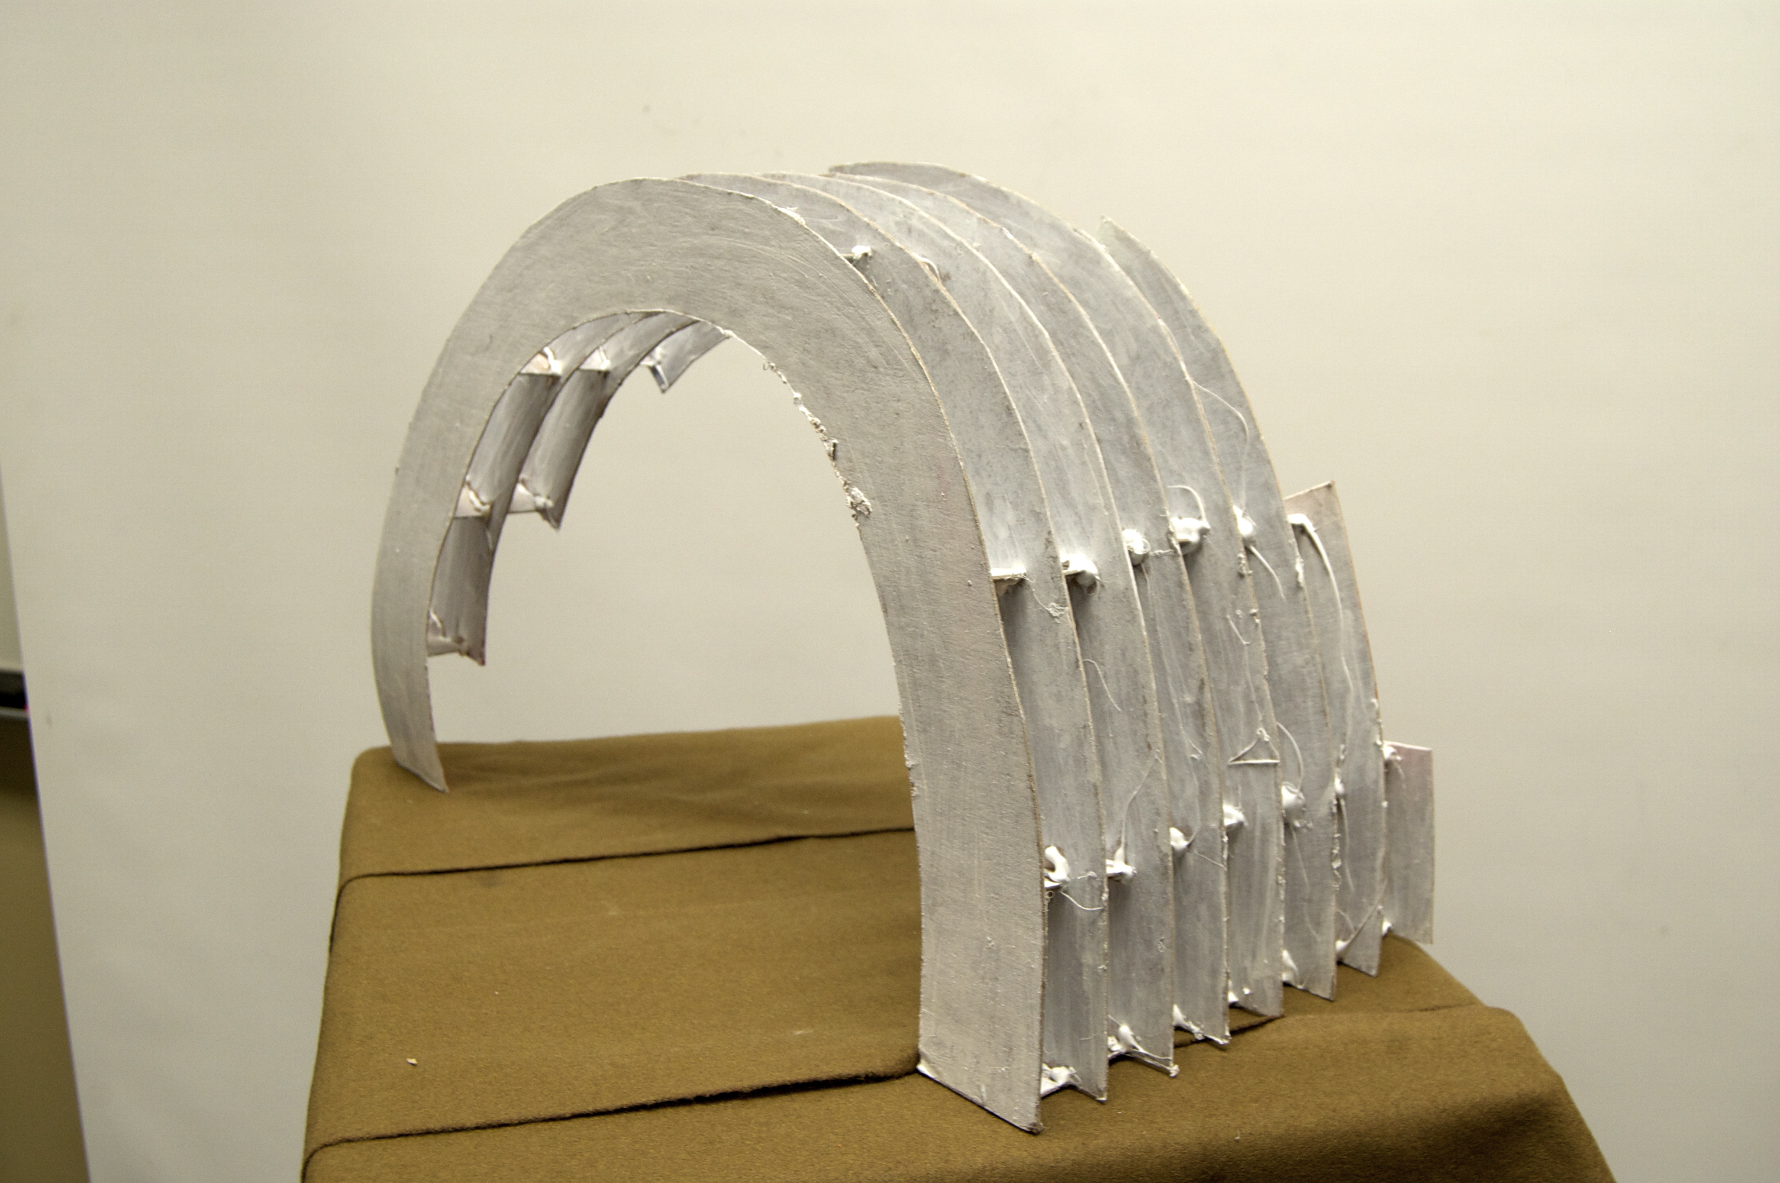
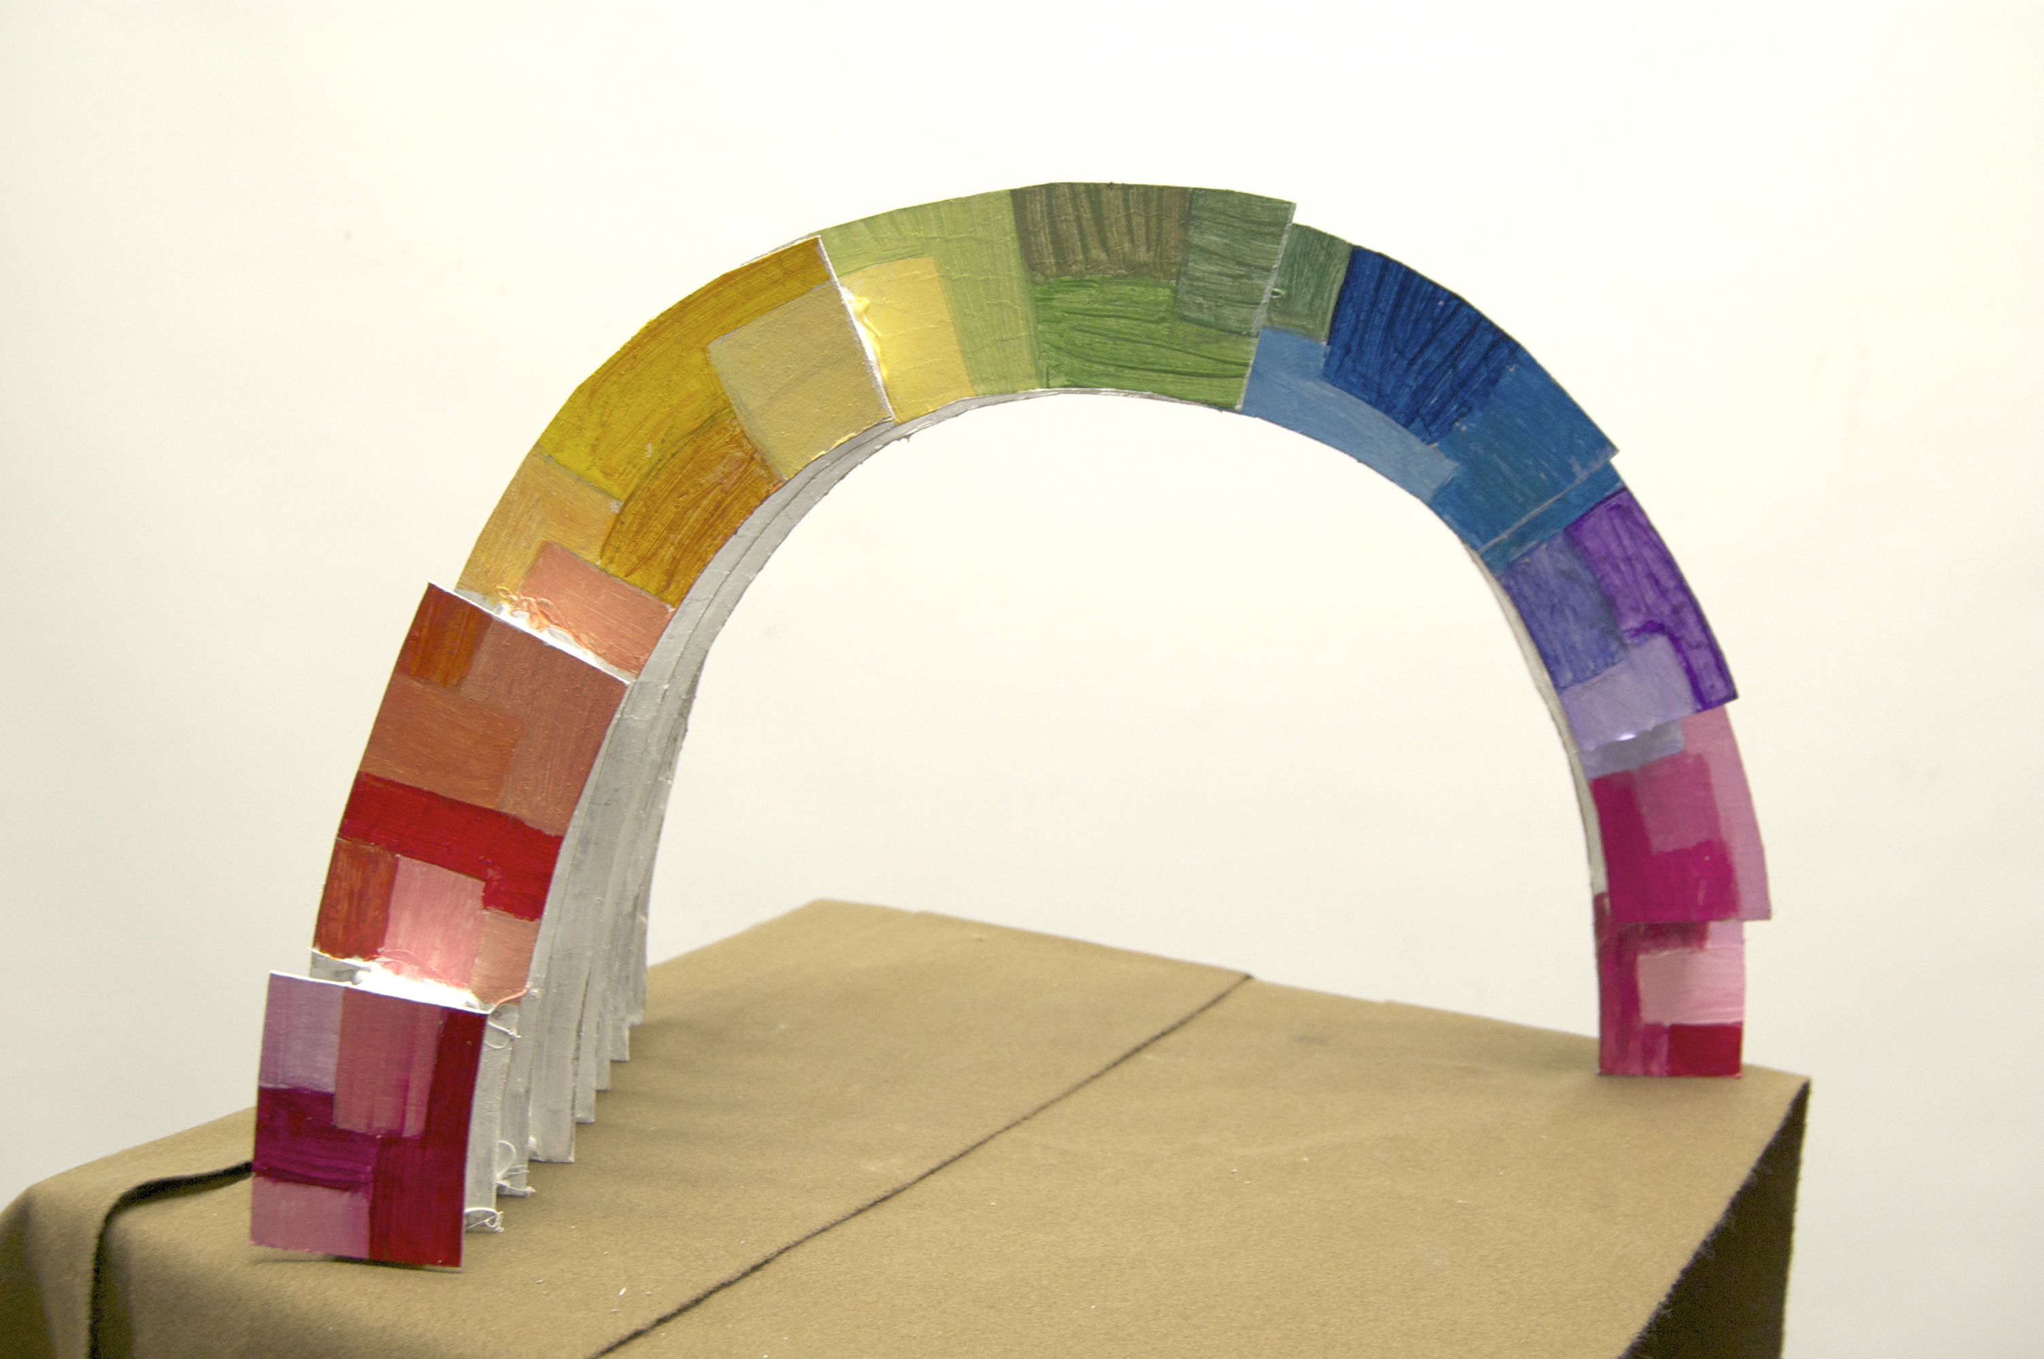

Slide 8
Bethany Schultz
My sculpture is inspired by the sculpture Prairie Engine by Marc Moulton. I used his idea of curved pieces combining to make a singular object to incorporate in my piece. My sculpture represents the diversity and growth of Urbandale. The changing colors represent the changes that have occurred with each new decade, each unique and special. The white on the rest of the sculpture shows the simple side of Urbandale. Even though on the outside we’re a vibrant town, if you dig deeper we’re a simple town with good morals and a big sense of community.
My sculpture was made out of cardboard. If it was built to scale, I would have it made out of metal. One strength in my sculpture is that it’s colorful yet simple at the same time.
My piece should be chosen because it’s interesting and vibrant and would look great in any part of the community, especially if it were placed near an elementary. After all, what kid doesn’t wan to walk through a tunnel, especially if there’s lots of colors?

Slide 9
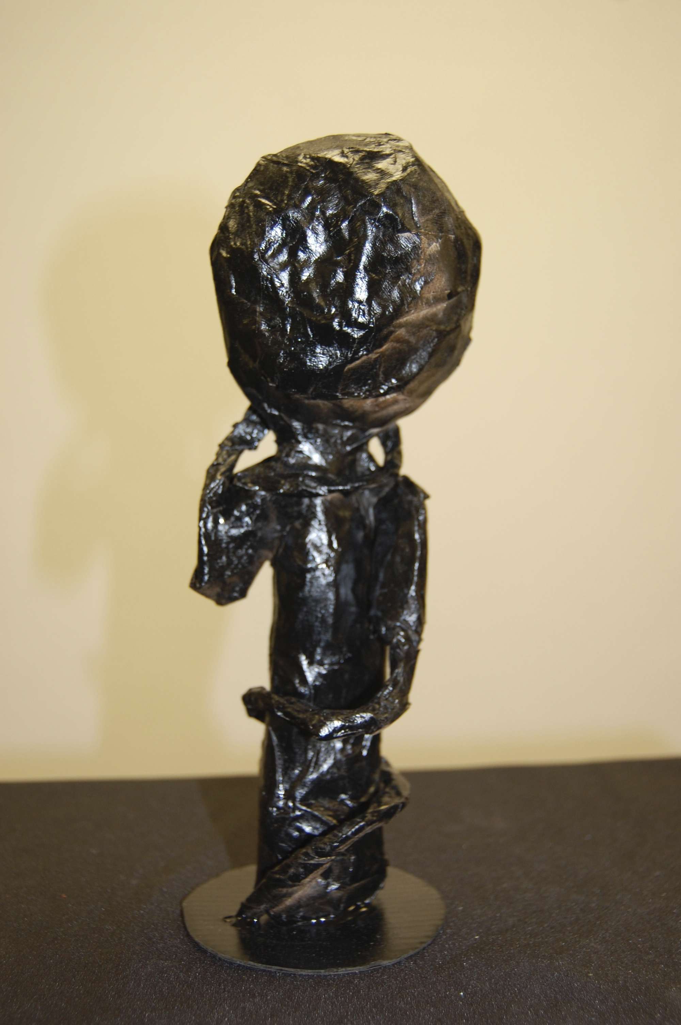
Jade

Slide 10
Jade
To get inspiration for our final project, my 3-D art class was given one sculpture to observe and analyze for ideas. The sculpture I received was “Post-Balzac” by Judith Shea, and I was instantly intrigued. All it was was a trench coat, except no one was wearing it. I got to thinking about what I wanted my project to be, and I discovered I wanted it to be eerie like the empty trench coat.
I chose a cardboard base for the body and made it 3D by crumpling newspapers and paper macheing them. I used wire for the twisting arms, and I paper mached those as well. I was finished by hot gluing the figure to the round base and spray painting it black.
The weakness with this piece was the color, because it is just plain black and if I had an extra day I could have painted it dark colors and mixed them in patterns. The strength with this piece is the arms. They look vine-like, which is how I wanted them to look. It comes off as eerie as I had hoped.

Slide 11
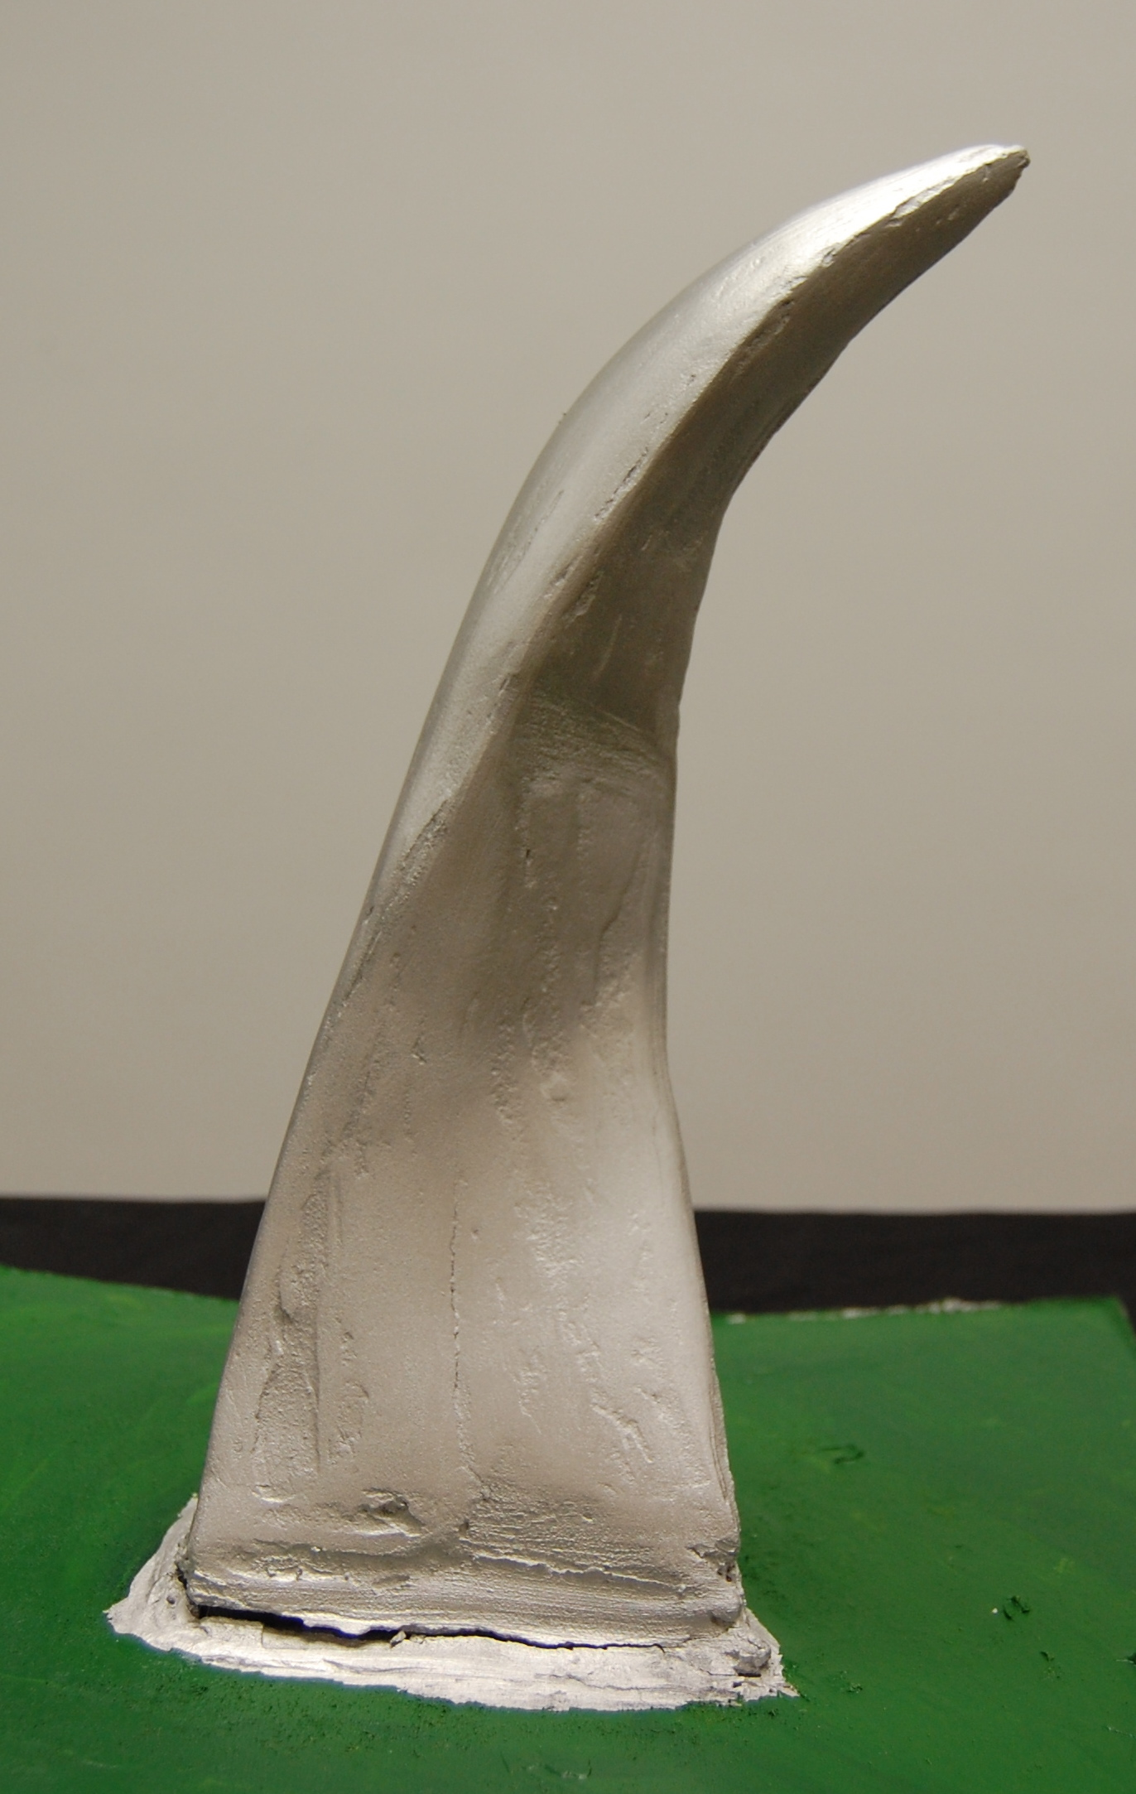
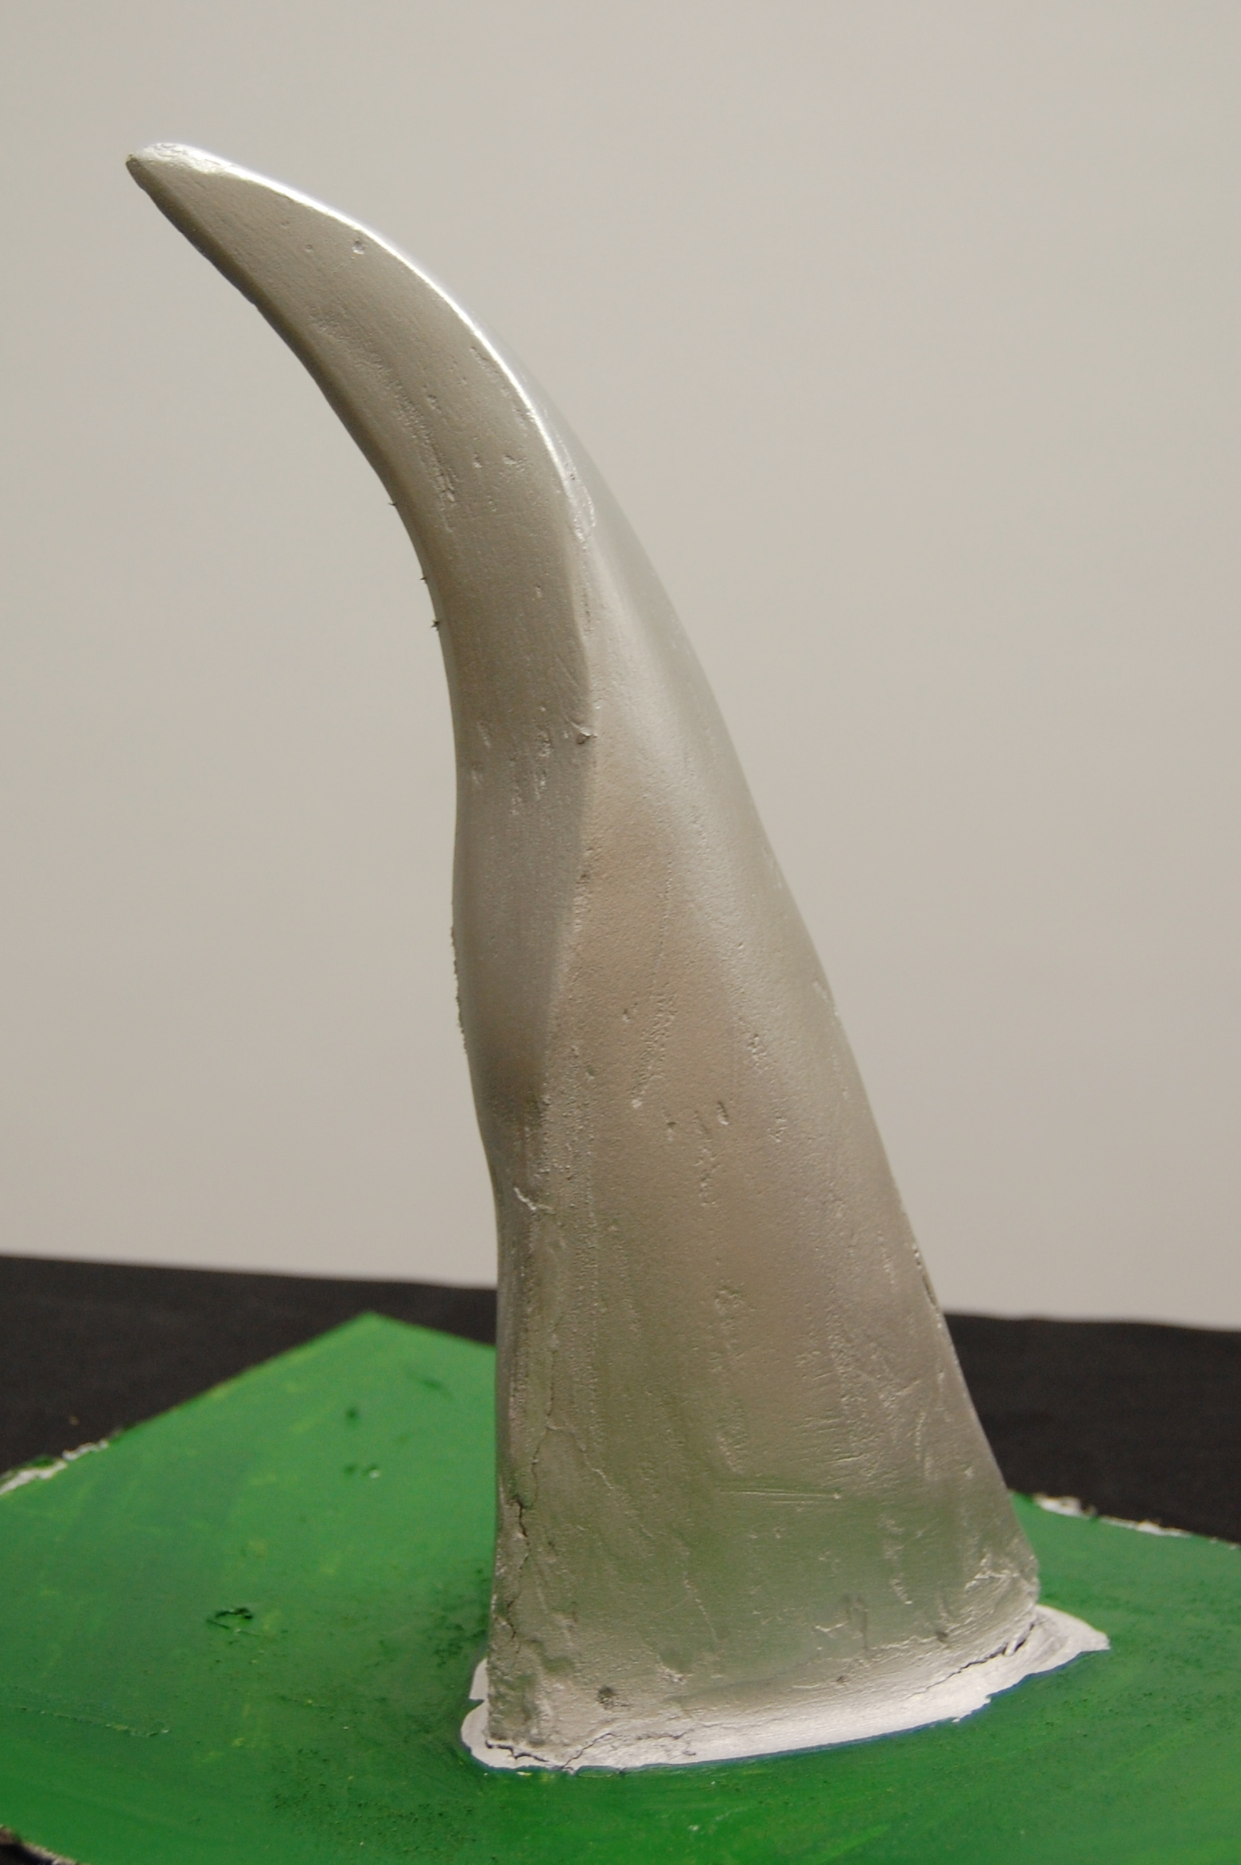
Rachel

Slide 12
Rachel Baratta - Siren
I titled my piece siren beauce of it’s beauty. The slight curve and twist that it has reminds of elegance. I would like my sculpture to be made of polished metal and have three sides that would twist together.

Slide 13
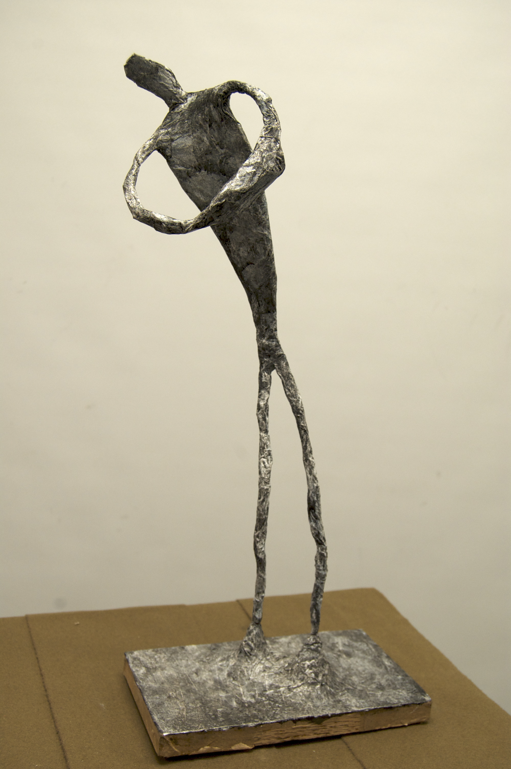
Sydney

Slide 14
Sydney Lafrentz
The art piece that I based my sculpture off was “Spider” by Louise Bourgeouis. This sculpture is a portrait of the artist’s mother; it is describing her mother as clever, patient, soothing, and useful, as a spider is. This artwork helped her move on after a troubled childhood, she used this to explore darker ideas about life, love, and death. The knobby-kneed spider indicates the darkness, and her troubled childhood. My goal with my project is to show the same skinny, knobby-kneed kind of artwork that the spider had, while also including the meaning of a mother.
I chose to use the style Alberto Giacometti used in his sculpture “the walking man”. I thought this would be a good technique to use because it would be slinky, and tall like the spider is. This man, or women, is in a position where he is holding a bundle, symbolizing a baby. I hoped this got the motherly part of Louise Bourgeouis sculpture across.
One strength of my sculpture is the height. I really wanted to make sure it was tall and skinny. Like the spider. My piece should be chosen for the public art piece because it represents the love of a mother, but also the darkness of life.

